Slide 1
Working with Amazon’s Alexa Skills Kit
Notes:
Talking Points:

Slide 2
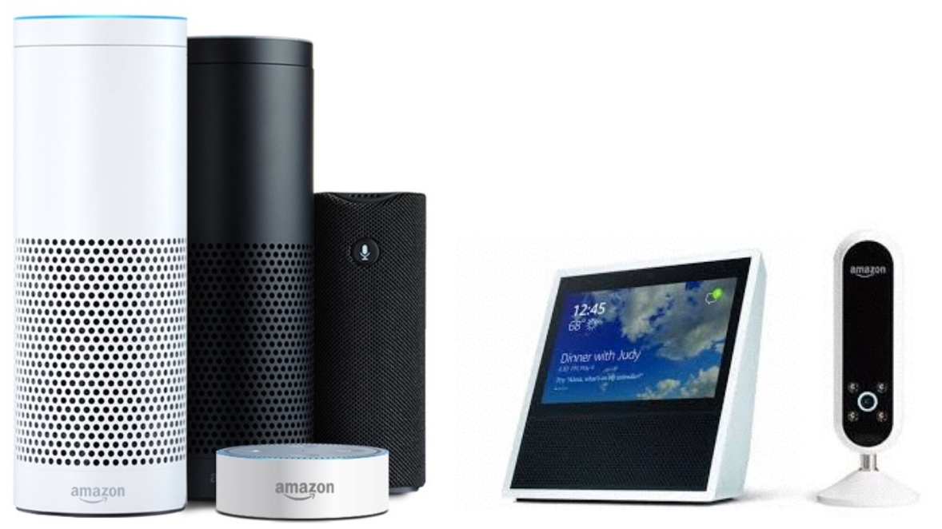
Available Amazon Devices

Slide 3
How the world views Alexa and our subscribers
Saturday Night Live did a faux commercial for Alexa Silver, an Alexa designed for “the greatest generation”:
http://www.nbc.com/saturday-night-live/video/amazon-echo/3518896?snl=1
Amazon Alexa VP Toni Reid agreed that the SNL spoof is “actually spot on”
https://www.geekwire.com/2017/amazon-alexa-chief-saturday-night-live-spoof-echo-speaker-actually-kind-spot/

Slide 4
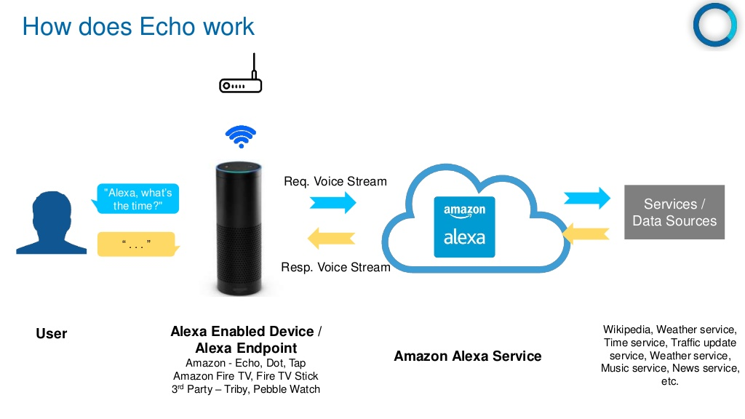

Slide 5
Definition of Terms
Wake Word: The word used to start an interaction with an Amazon device. Current wake words are: Alexa, Echo, Amazon, and Computer.
Invocation Name: The two or more word name that a user will use to start a dialog.
Skill: The application that responds to an invocation
Intent: The action or request that a user can interact with.
Utterance: The words that a user will use to invoke an intent
Slot: Custom values used in intents.

Slide 6
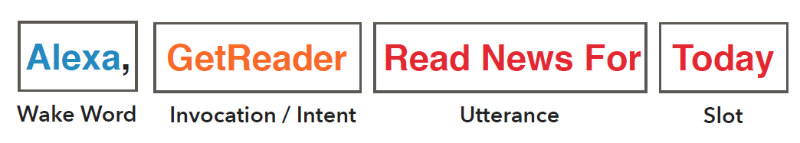
Putting the terms together as a skill

Slide 7
Voice Interface Design
“you cannot fully live up to the user’s expectations of a natural conversation partner, it becomes even more important to design the voice user interface so that it contains the right amount of information and handles the user’s expectations elegantly.”
Notes:
VUIs are life-changing for those who can’t easily adapt themselves for traditional computer use.
Voice user interfaces are very different from graphical user interfaces , NO visual affordances
Because speech is so fundamental to human communication, we cannot completely disregard our expectations for how speech communication normally takes place, even if we are fully aware that we are speaking to a device rather than a person.
Voice UIs allow us to remain fully human in our interactions. They allow us to remain more connected to the other humans in the room. And these VUIs are life-changing for those who can’t easily adapt themselves for traditional computer use.
So the need for voice user experiences — even today’s crop of control-focused, less conversational UIs — is real, and these experiences change lives. You might not be replacing your existing experience, but even adding voice UI to extend an existing experience can have a major impact on your customers4
voice user interfaces are very different from graphical user interfaces—you cannot apply the same design guidelines. In voice user interfaces, you cannot create visual affordances. Consequently, looking at one, users will have no clear indications of what the interface can do or what their options are.

Slide 8
Voice Design Principle #1 Be Aware of cognitive load
Be brief - One-breath test
Use brevity, arrangement, and pacing when listing options
Do :
Alexa : Here are cheeses that you may like. Cheddar and Gouda, as well as Gorgonzola, Parmesan, and Brie.
Don’t :
Alexa : The cheeses you may like are Cheddar, Gouda, Jarlsberg, Porter Cheddar, St. Agur Blue Cheese, Gorgonzola, Brie, Gruyere, Sharp Cheddar, and Reggiano Parmesan.

Slide 9
Voice Design Principle #2 Guide User
Prompt with guidance for the user
Alexa :Let’s plan this trip. What city would you like to visit?
Provide definitive choices
Alexa : We have Brie or Gouda. Which would you like?
Where am I
When the user e.g. asks for today’s weather:
Alexa : “Today’s weather forecast in Horsham is mostly sunny and dry”

Slide 10
Voice Design Principle #3 Speak Natural
Speak and write naturally, Add variety
Remember what was said
Use conversation markers
Timeline Markers : First,” “halfway there,” “then,” and “finally”
Acknowledgements and feedback : "Thanks" , "Got it“
Transitions "Now,” “so,” “all right,” help to introduce change when moving to a different topic.
Alexa : Okay, there are three steps to wash a sweater. (half-second pause)
Alexa : First, turn the sweater inside out and wash it on the gentle cycle using regular detergent. (half-second pause)
Alexa : Next, put the sweater in the dryer for 10 minutes at low temperature. (half-second pause)
Alexa : Then, lay the sweater a flat surface to finish drying. That’s it!

Slide 11
Tools to use
Blueprints:
https://blueprints.amazon.com/
Alexa Developer Console:
https://developer.amazon.com/edw/home.html#/
Amazon Web Services (AWS):
https://console.aws.amazon.com/console/home
Lambda service – Hosts services
CloudWatch – Logs
Skill Code Generator:
https://s3.amazonaws.com/knight-sunglasses/index.html
Skill Testing Tool:
https://echosim.io/welcome
Storyline Tool:
https://getstoryline.com/

Slide 12
Let’s build a skill!
Demo

